Slide 1
Modern Anomaly and Novelty Detection
Notes:
Detecting outliers or anomalies is one of the core problems in Machine Learning and it has recently become an active research topic with the exploding growth of big data and AI techniques in lots of applications

Slide 2
Definition of anomaly
“Something that deviates from what is standard, normal, or expected” Oxford Dictionary
Similar Concepts:
Outlier detection
Novelty detection
Out-of-Distribution detection
Rare events detection
Notes:
First, let's start with the definition!
People will refer to it by diff names!
Anomalies can be caused by errors in the data but sometimes are indicative of a new, previously unknown, underlying process
Some of the most common causes of outliers are as a result of a mechanical fault, changes in system behavior, fraudulent behavior, ,human error, instrument error, setup error, sampling errors, data-entry error, and environmental changes.

Slide 3
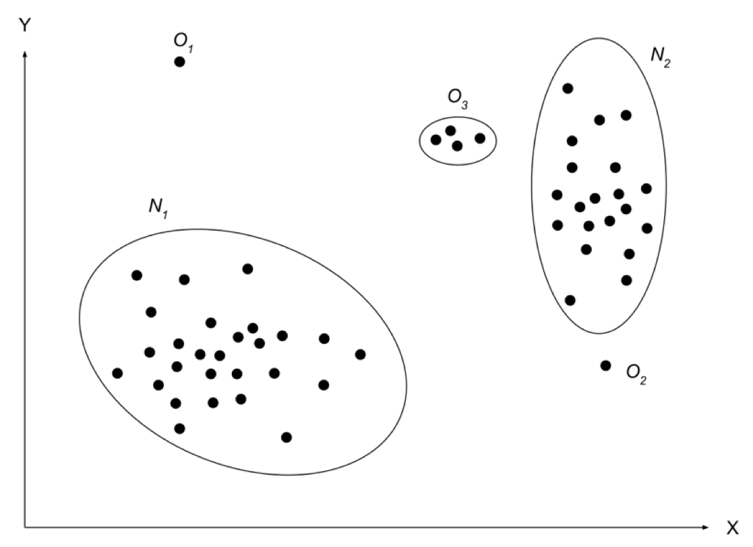
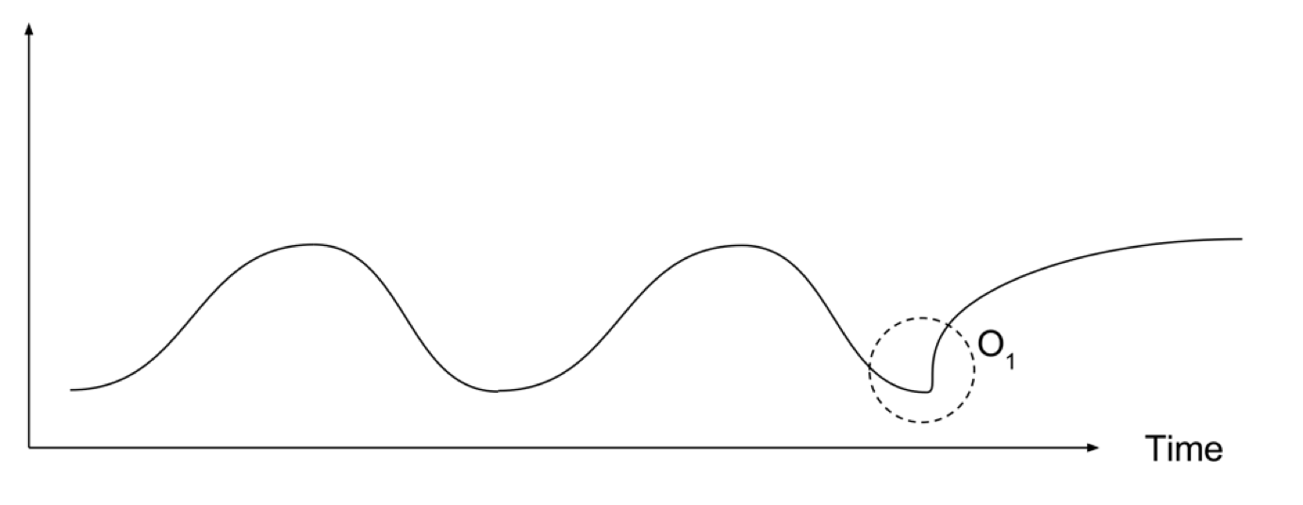
Definition of anomaly
Anomalies are patterns in the data that do not conform to a well-defined notion of normal behaviour
Notes:
Point anomalies/Global anomalies: A single instance of data is anomalous if it's too far off from the rest. example: Detecting credit card fraud based on "amount spent."
Contextual anomalies: The abnormality is context specific. This type of anomaly is common in time-series data. example: Spending $100 on food every day during the holiday season is normal, but may be odd otherwise.: temperature data, Stock market
N1 and N2 are regions consisting of a majority of observations and hence considered as normal data instance regions, whereas the region O3, and data points O1 and O2 are few data points which are located further away from the bulk of data points and hence are considered anomalies.

Slide 4

Anomaly
Clearly visible outlier in this list:
[20,24,22,19,29,18,4300,30,18]
Two important characteristics:
Anomalies are different from the norm with respect to their features and
They are rare in a dataset compared to normal instances.
Notes:
It is easy to identify it when the observations are just a bunch of numbers and it is one dimensional but when you have thousands of observations or multi-dimensions, you will need more clever ways to detect those values. This is what this workshop will try to cover.
today anomalies are known to have two important characteristics:
Anomalies are different from the norm with respect to their features and
They are rare in a dataset compared to normal instances.

Slide 5
Example Applications
Intrusion detection
Fraud detection
Industrial damage detection
Medical and public health
Image processing
Anomaly detection in text data
Sensor networks and other domains
Fake News and information, social network
Data quality and cleaning
Notes:
Fraud: banking , insurance (car, health) In fraud detection, if a card is stolen, the buying behavior of the card user usually changes; we will notice an abnormal buying pattern. The same is valid for unauthorized access in computer networks, which results in an unusual pattern.
Detecting these abnormal (outlier) patterns is essential for security.
Healthcare is an important component in people’s lives, waste, abuse, and fraud drive up costs in healthcare by tens of billions of dollars each year. Healthcare insurance claims fraud is a significant factor to increased healthcare costs, but its impact can be decreased through fraud detection.
It can help in predicting rare diseases in healthcare. (smart watch, ECG, Heart failure)
One example is patient monitoring, where electrocardiography (ECG) signals or other body sensors are used to detect critical, possibly life-threatening situations
Fake News: In recent times, social media has given a platform for people to spread fake news continually. Sometimes, it is difficult to differentiate between real and fake news.
Or it can be simply used to clean our data and improve our model performance.

Slide 6
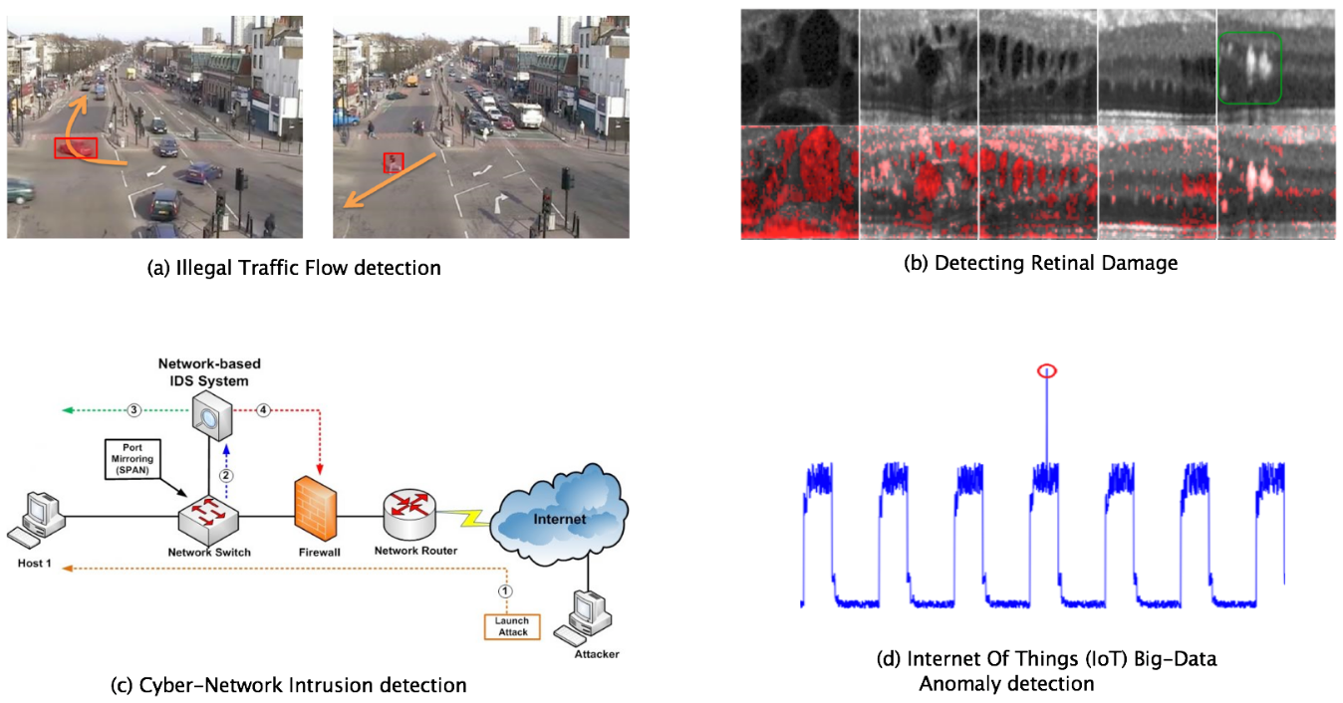
Example Applications
https://arxiv.org/abs/1901.03407
Notes:
Detecting anomalies can help in predicting accidents in traffic patterns for autonomous driving cars.
We now have smart watches and wristbands that can detect our heartbeats every few minutes. Detecting anomalies in the heartbeat data can help in predicting heart diseases.
Anomalies in traffic patterns can help in predicting accidents. It can also be used to identify bottlenecks in network infrastructure and traffic between servers.

Slide 7

System 1 and System 2
Thinking, Fast and Slow
System 1: automatic, fast and often unconscious
Provide anomaly detection
System 2: slower, more analytical method of thinking
Planning, reasoning
Bengio’s presentation at NeurIPS:
“From System 1 Deep Learning to System 2 Deep Learning”
Notes:
Humans are always watching for something weird or out of the ordinary.
Our brain is in a constant state of anomaly detection.
in this book Thinking, Fast and Slow:
System 1 and System 2 are two different modes of decision making: System 1 is an automatic, fast and often unconscious way of thinking.
It is efficient, requiring little energy or attention, but it can be biased and make systematic errors.
System 2 is an effortful, slow and controlled way of thinking.
it is our instincts, what it calls System 1, that provide anomaly detection so we can identify the things that violate the internal models of the world. Then System 2, our slower, more analytical method of thinking, takes over to figure out what’s actually going on.
In the machine learning sense, anomaly detection is learning or defining what is normal, and using that model of normality to find interesting deviations/anomalies.

Slide 8
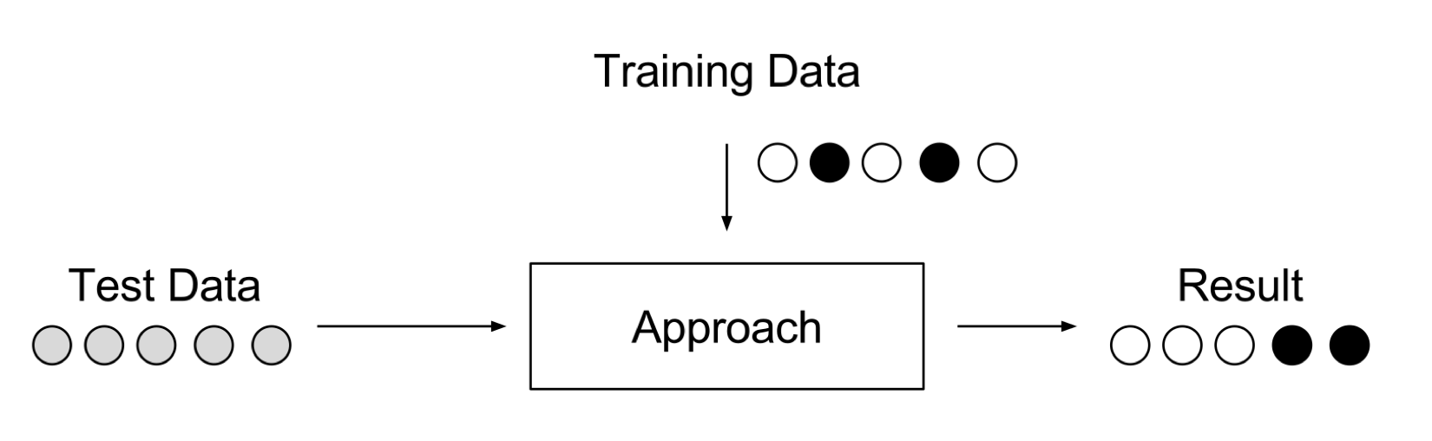
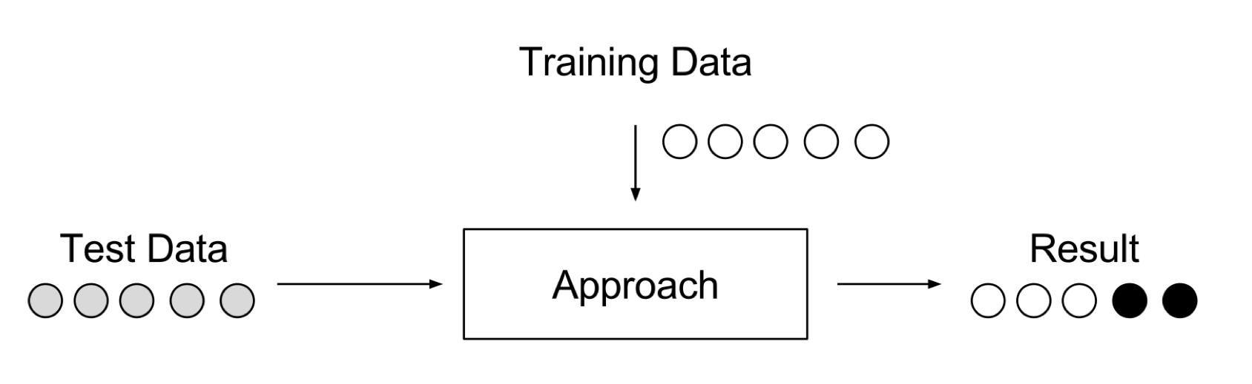
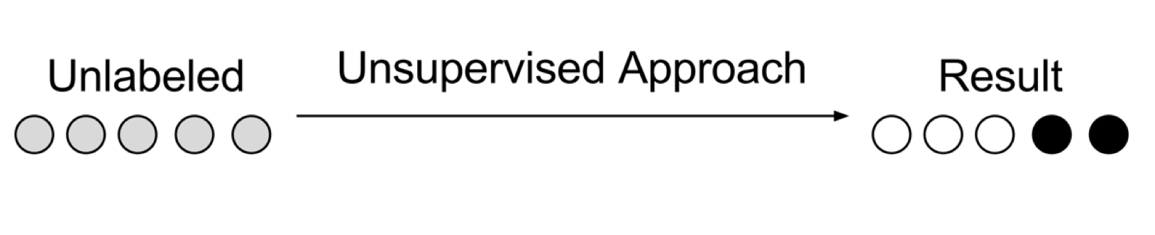
Anomaly detection approaches
Supervised Anomaly Detection
Need Class imbalance handling
Semi-supervised Anomaly Detection
One-class Classification
Density estimation approach
Generative models
Autoencoders
Unsupervised Anomaly Detection
Distance-based methods
Density-based methods
Clustering-based methods
https://towardsdatascience.com/a-note-about-finding-anomalies-f9cedee38f0b
Notes:
We can categorise the AD in to 3 groups
Supervised: Not all classification approaches suit for this task. No all the models can deal well with unbalanced data
(the total number of positive class instances are far more than the total number of negative class of data)
Drawback: need to know all anomalies and label data correctly. For many cases anomalies are not known in advance or may occur as novelties during the test phase.
Semi: only training data consists of normal data without any anomalies.
Semi: learn features/pattern from the normal class alone that can then be used to identify everything that does not look like the normal class.
Unsuper: when we do not know, what is normal in the data and what is not.
the weakness of supervised approaches is that they require lots of effort in labeling data. On the contrary, semi-supervised and unsupervised methods do not require many data labeling, making them desirable, especially for rare/unseen anomalous cases
Dist based: A data point that is at a far distance from its nearest neighbor is regarded as an outlier.
Clustering-based techniques generally rely on using clustering methods to describe the behavior of the data.
To do this,the smaller size clusters that have significantly fewer data points than other clusters are labeled as outliers

Slide 9
Anomaly Detection Techniques
Statistical Methods
Gaussian Mixture model
HBOS
Kernel Density Estimation
Classical Machine Learning-Based Approaches
k-nearest neighbor
Clustering technique
IForest
one-SVM
Deep learning based Approaches
Autoregressive neural density estimators
Autoencoders
GANs
Notes:
Outlier detection methods have been classified into different techniques such as statistical-based methods,
Stat: flag the data points that deviate from common statistical properties of a distribution
( Let's say the definition of an anomalous data point is one that deviates by a certain standard deviation from the mean.
For this type of method that has an assumption of the underlying distribution model, a well-known methods adopted for outlier detection are the Gaussian Mixture model)
ML: one class classification approaches that learn a discriminative boundary around normal data, such as one-class SVM
Deep:
large-scale data, learning the hierarchical discriminative features from the data
Traditional methods are suboptimal on the image or sequence datasets since it fails to capture complex structures in the data
neural networks have some key advantages when dealing with complexity, such as the ability to work on high-dimensional data, at scale, with flexible architectures.
AR: Density estimators learn a probability density function over the data distribution: PixelCNN, LM
(ML: Density-Based Anomaly Detection; Assumption: : Normal data points occur around a dense neighborhood and abnormalities are far away.
k-NN is a simple, non-parametric lazy learning technique used to classify data based on similarities in distance metrics such as Eucledian, Manhattan, Minkowski, or Hamming distance.
Clustering: Assumption: Data points that are similar tend to belong to similar groups or clusters, as determined by their distance from local centroids.
)

Slide 10
Deep learning based Approaches
Deep Neural Networks
Deep Belief Networks (DBNs)
Deep Generative Models
Variational Autoencoders (VAE)
Adversarial autoencoders (AAE)
Generative Adversarial Networks (GANs)
Sequential Models
Recurrent Neural Networks (RNNs)
Autoencoders
Self-supervised learning
Notes:
Generative models aim to learn exact data distribution in order to generate new data points with some variations. The some common and efficient generative approaches are Variational Autoencoders (VAE), aae, gan
Leveraging this ability of learning input distributions, several Generative Adversarial Networks-based Anomaly Detection (GAN-AD) frameworks proposed are shown to be effective in identifying anomalies on high dimensional and complex datasets.
Gen:Using generative models for likelihood estimation
RNN: are shown to capture features of time sequence data.
AE: Learn to reproduce your input
Self-S: Learn to predict some part of your data (self-supervised learning): this is also universal, but choosing what to predict is decisive (domain expertise steps in). Again, prediction / misclassification error is your proxy to detect anomalies.
time-series forecasting can be a suitable self-supervised task for anomaly detection

Slide 11
Statistical Methods
Parametric methods
Standard Deviation
GMM
Box plots
Nonparametric methods
Histogram-based Outlier Score (HBOS)
Notes:
Statistical methods assume that the normal data follow some statistical model
The idea is to learn a generative model fitting the given data set, and then identify the objects in low probability regions of the model as outliers.
The effectiveness of statistical methods highly depends on the assumption for the distribution.
A parametric method assumes that the normal data objects are generated by a parametric distribution with parameter 𝜃.
In nonparametric methods for outlier detection, the model of “normal data” is learned from the input data, rather than assuming one a priori.
Nonparametric methods often make fewer assumptions about the data and thus can be applicable in more scenarios

Slide 12
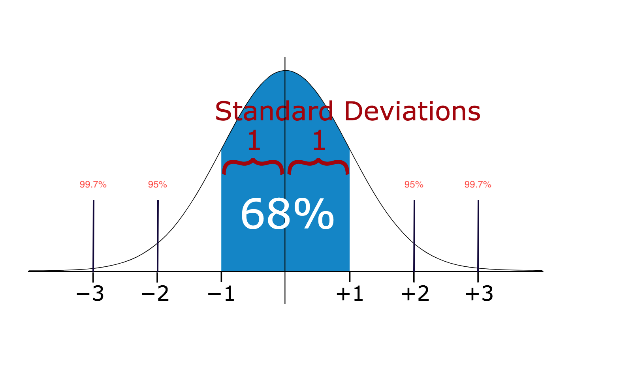
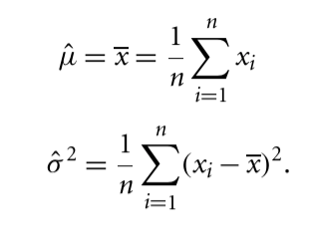
Standard Deviation
Data distribution ≈ Normal
Anomaly : Any data point that is more than 3 times the standard deviation
Notes:
In statistics, If a data distribution is approximately normal then about 68% of the data values lie within one standard deviation of the mean and about 95% are within two standard deviations, and about 99.7% lie within three standard deviations
Therefore, if you have any data point that is more than 3 times the standard deviation, then those points are very likely to be anomalous or outliers.
Z score!
≈68% percent of the data falls within 1 standard deviation of the mean
≈95% percent of the data falls within 2 standard deviations of the mean
≈99.7% percent of the data falls within 3 standard deviations of the mean

Slide 13
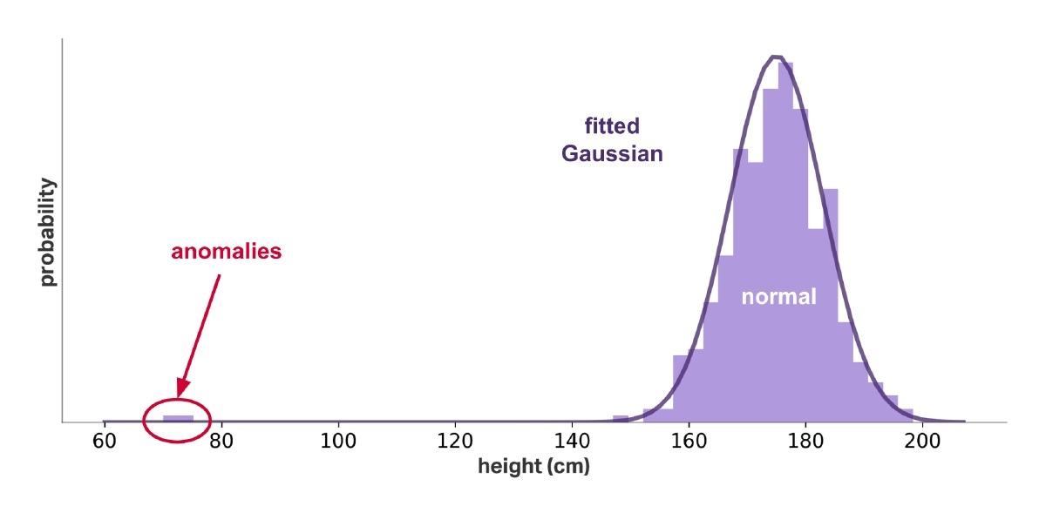
Standard Deviation
Univariate data with a normal distribution
Notes:
consider the univariate data with a normal distribution. We will detect the outlier using methods of maximum likelihood
The main drawback for the parametric model is that in many cases, data distribution may not be known.
For example, if we have two big clusters the assumption about normal distribution wouldn’t work well.

Slide 14
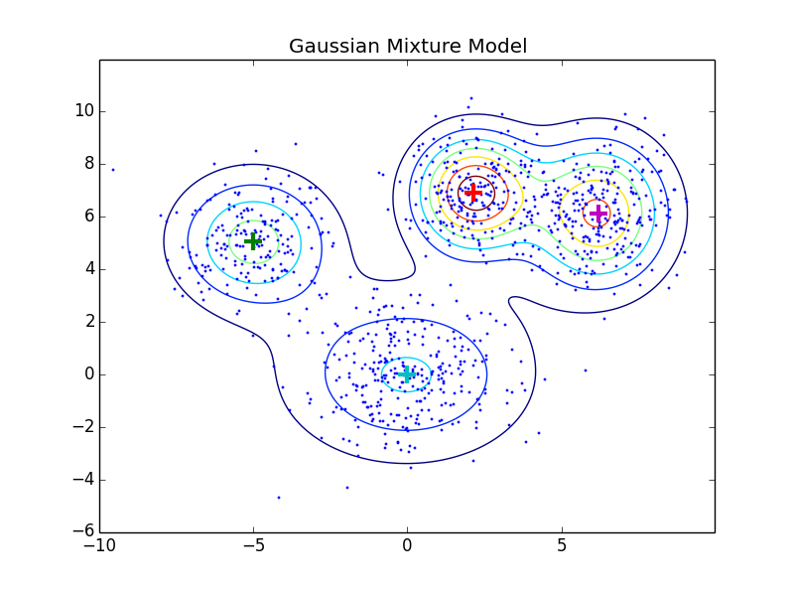
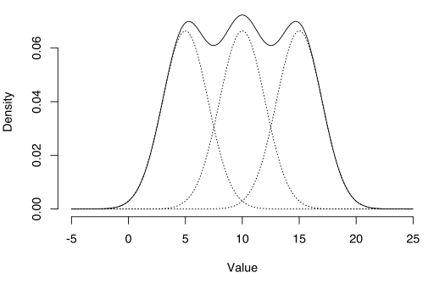
Gaussian Mixture Model
Normal data objects are generated by multiple normal distributions
Notes:
Instead, we assume that the normal data objects are generated by multiple normal distributions
and for every object o in the dataset, we calculate the probability that is generated by the mixture of the distribution.
data follow a mixture model is that the data looks multimodal,

Slide 15
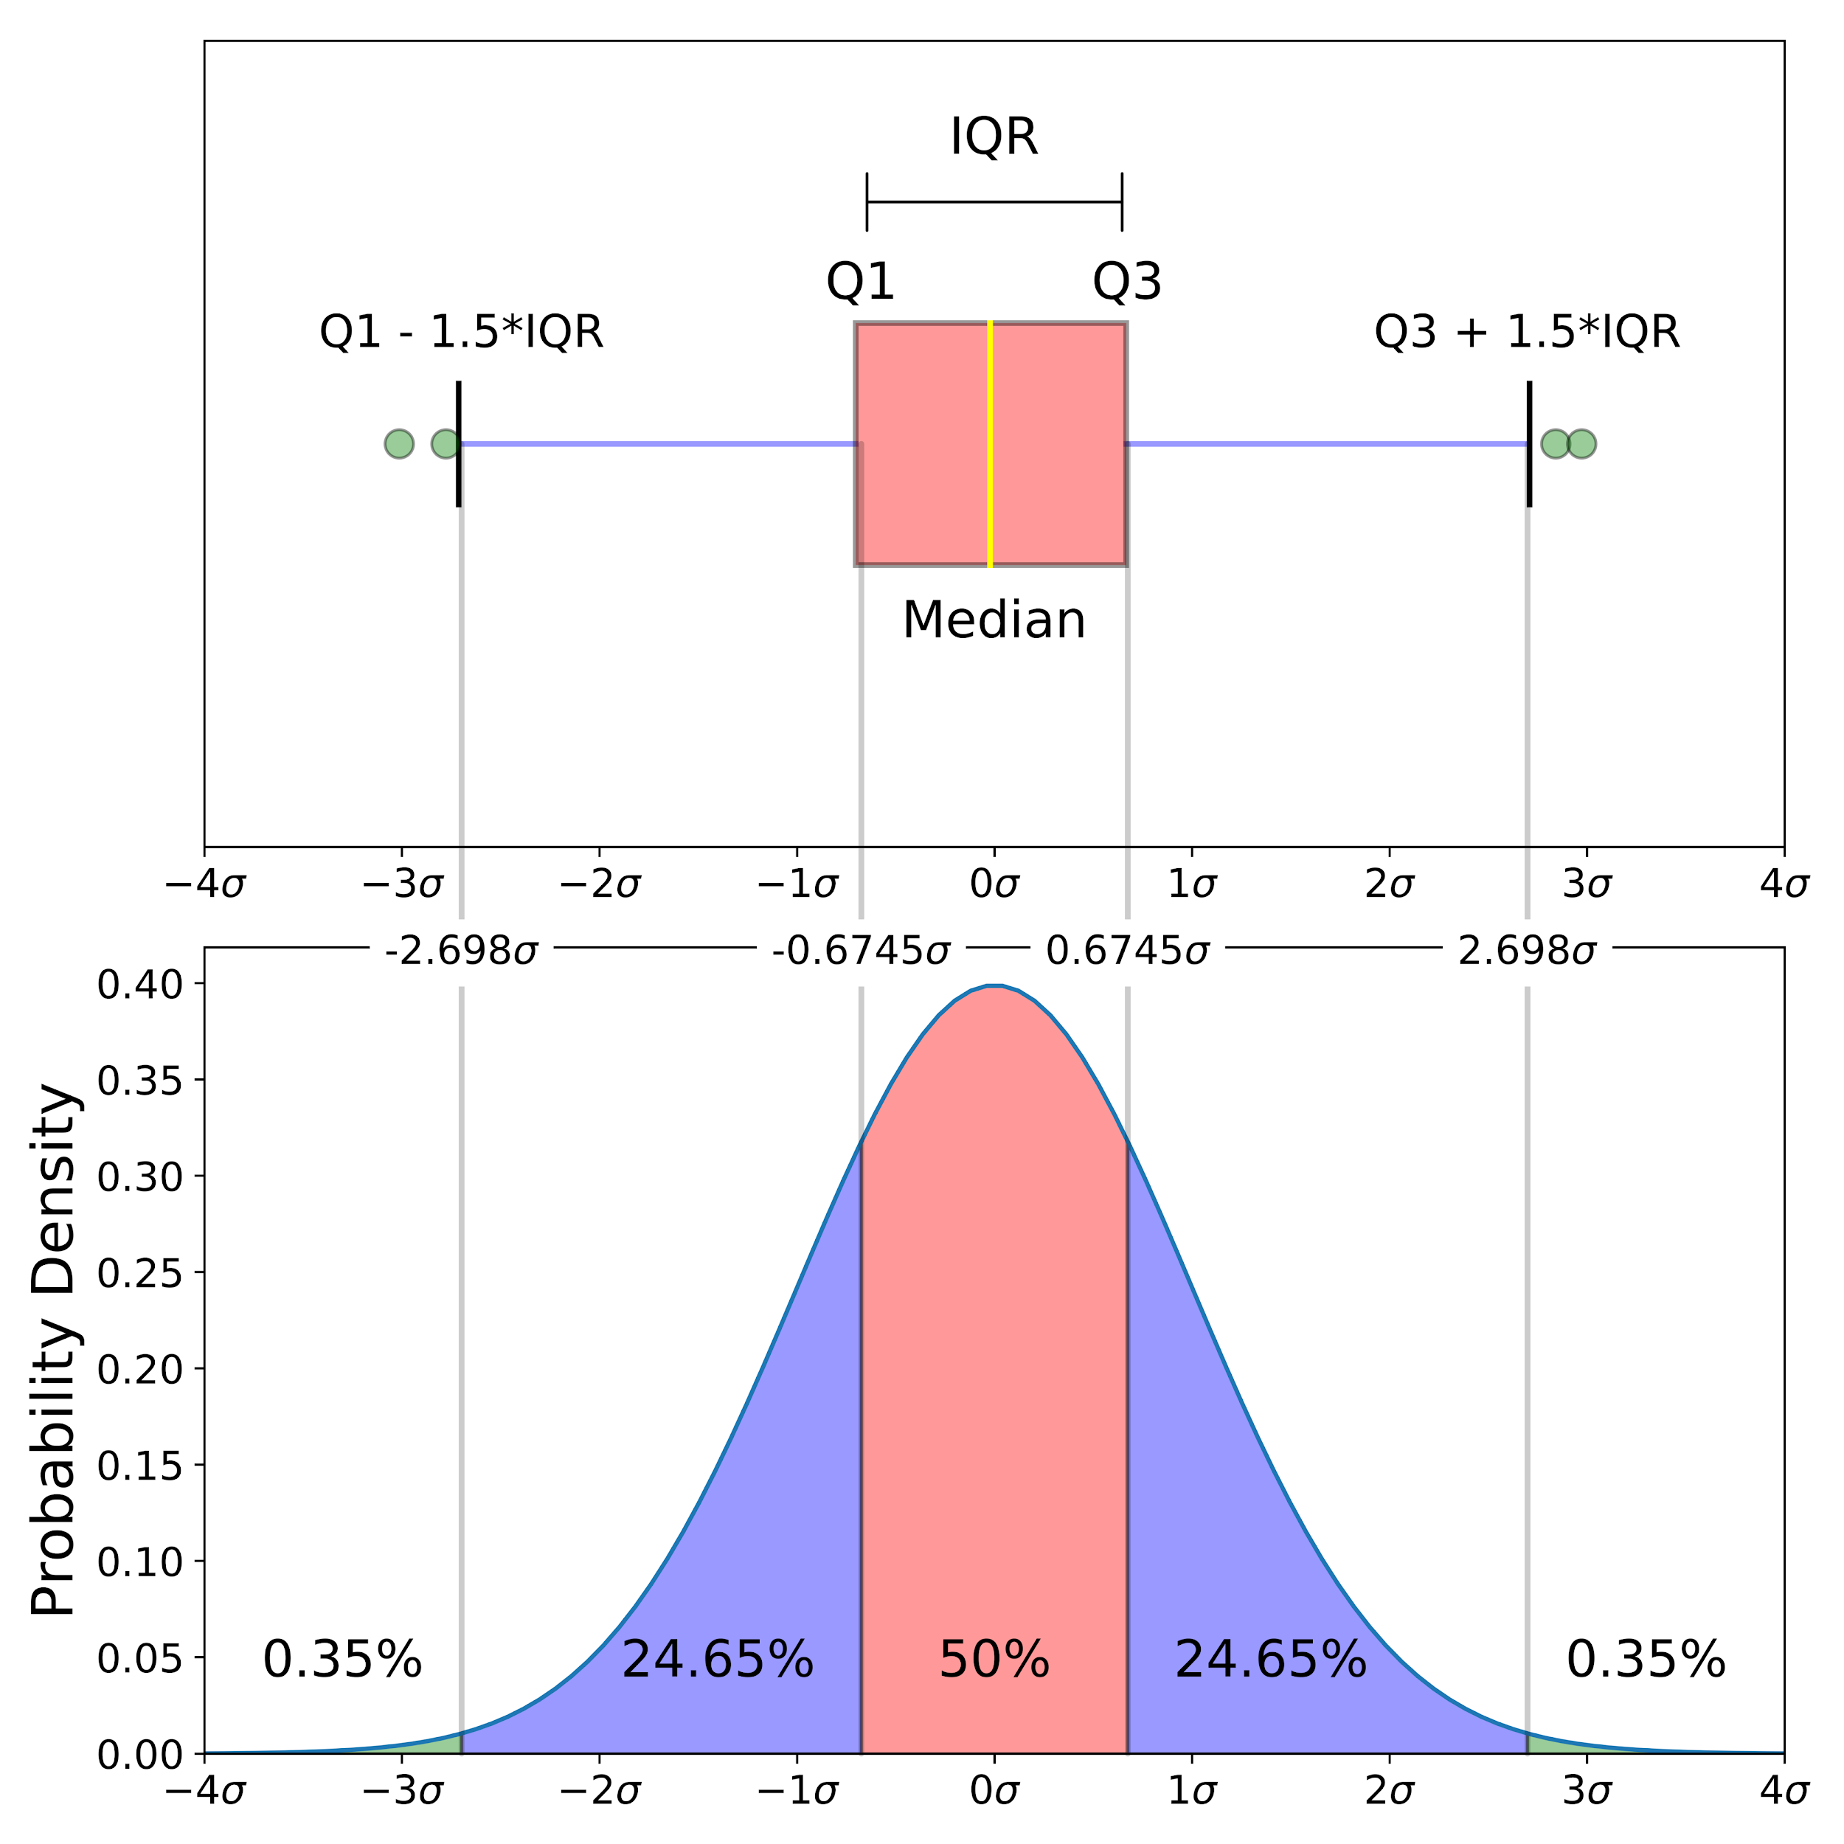
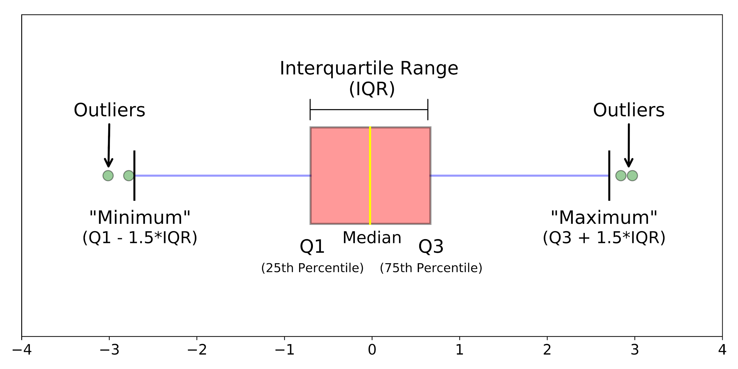
Boxplots
Graphical depiction of numerical data
Five numbers:
Minimum
First quartile (Q1)
Median
Third quartile (Q3)
Maximum
Notes:
Boxplots are a standardized way of displaying the distribution of data based on a five number summary
A boxplot is a graph that gives you a good indication of how the values in the data are spread out.
median (Q2/50th Percentile): the middle value of the dataset.
first quartile (Q1/25th Percentile): the middle number between the smallest number (not the “minimum”) and the median of the dataset.
third quartile (Q3/75th Percentile): the middle value between the median and the highest value (not the “maximum”) of the dataset.
interquartile range (IQR): 25th to the 75th percentile.
outliers (shown as green circles)
“maximum”: Q3 + 1.5*IQR
“minimum”: Q1 -1.5*IQR
It is a very simple but effective way to visualize outliers.
Think about the lower and upper whiskers as the boundaries of the data distribution.
Any data points that show above or below the whiskers, can be considered outliers or anomalous.
skewness

Slide 16
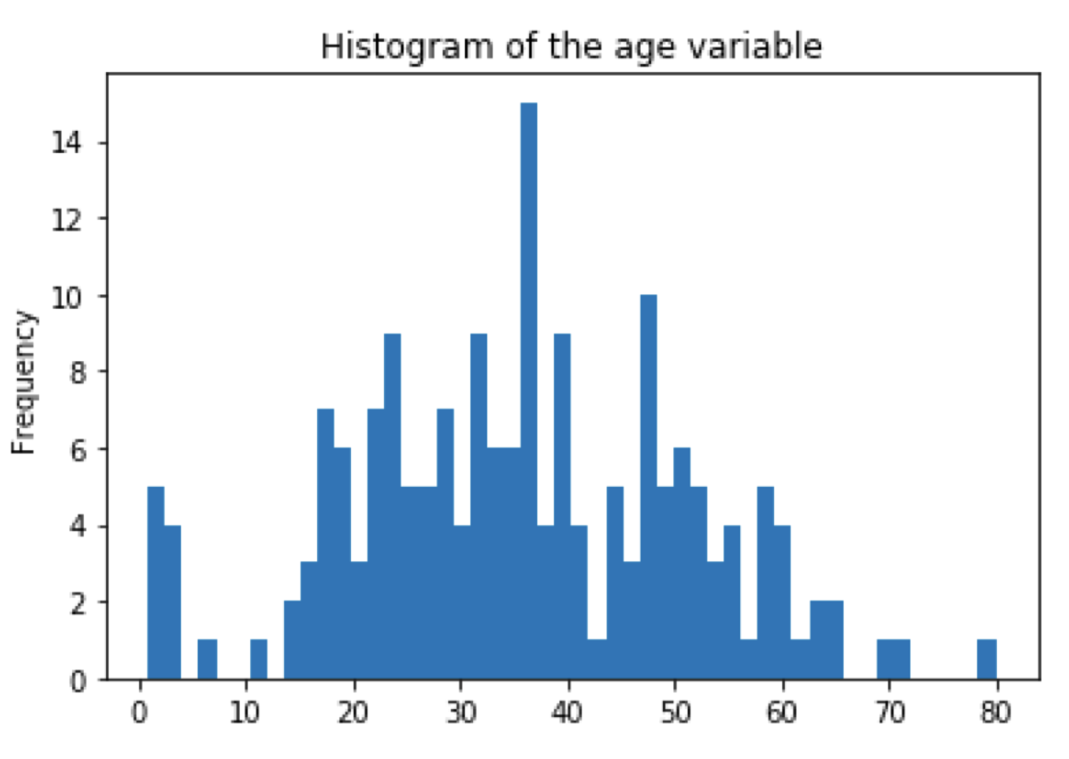
Histogram-based Outlier Score (HBOS)
Assumes independence of the features
Faster than multivariate approaches at the cost of less precision
Detect global outliers
Performs poor on local outlier
Notes:
HBOS assumes the feature independence and calculates the degree of anomalies by building histograms.
In multivariate anomaly detection, a histogram for each single feature can be computed, scored individually and combined at the end.
The basic idea is, that for each feature of the dataset, a histogram is created. Then, for each instance in the dataset, the inverse height of the bins it belong to (representing the density estimation) of all features are multiplied.
It assumes independence of the features making it much faster than multivariate approaches at the cost of less precision.
A comparative evaluation on three UCI data sets and 10 standard algorithms show, that it can detect global outliers as reliable as state-of-the-art algorithms, but it performs poor on local outlier problems.
The drawback — it is hard to choose the bin size.

Slide 17
Distance-Based Anomaly Detection
Outlier: A data point that is at a far distance from its nearest neighbor
k-NN
Local Outlier Factor (LOF)
Notes:
Dist based: A data point that is at a far distance from its nearest neighbor is regarded as an outlier.

Slide 18
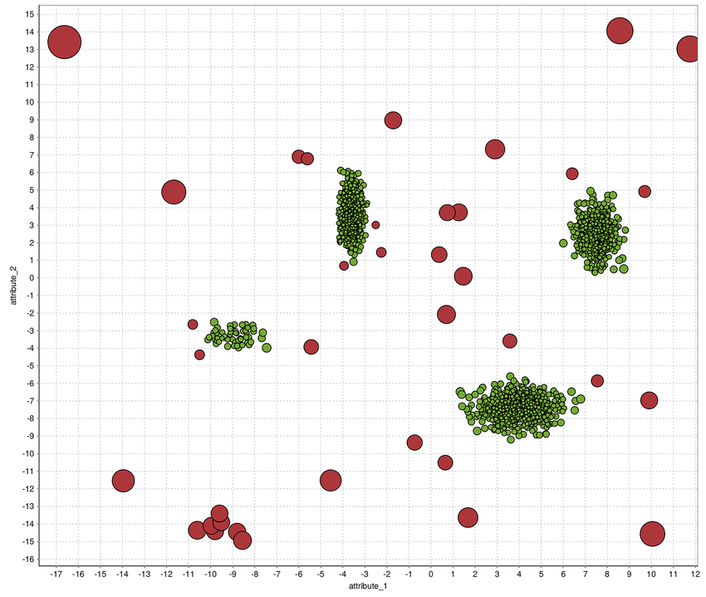
k-NN
K-nearest-neighbors
Anomaly score = Distance to
kth-nearest-neighbor (a single one)
average distance to all of the k-nearest-neighbors
Best K ?
Notes:
k-NN is a simple, non-parametric lazy learning technique used to classify data based on similarities in distance metrics such as Eucledian, Manhattan, Minkowski, or Hamming distance.
First, for every record in the dataset, the k-nearest-neighbors have to be found. Then, an anomaly score is computed using these neighbors, whereas two possibilities have been proposed: Either the distance to the kth-nearest-neighbor is used (a single one) or the average distance to all of the k-nearest-neighbors is computed.
The choice of the parameter k is of course important for the results.

Slide 19
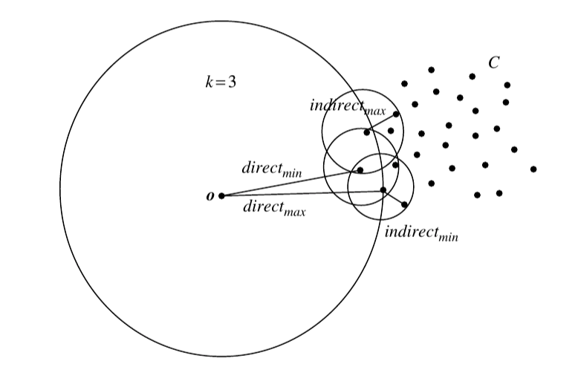


Local Outlier Factor (LOF)
Finding k-nearest-neighbors
Local density for a record is estimated
LOF computation
Notes:
The LOF method scores each data point by computing the ratio of the average of densities of the neighbors to the density of point itself.
The k-nearest-neighbors have to be found for each record x.
Using these k-nearest-neighbors N_{k}, the local density for a record is estimated by computing the local reachability density (LRD) :
= inverse of average distance to the k nn : distance : Euclidean distance
Finally, the LOF score is computed by comparing the LRD of a record with the LRDs of its k neighbors
The local outlier factor is the average of the ratio of the local reachability density of o and those of o’s k-nearest neighbours.
The lower is the local reachability of o and the higher the reachability of k nearest neighbors of o higher the LOF.
The LOF value of less than 1 is an indicator that the observation is not an outlier, while a value greater than 1 indicates an outlier. The cut-off can be higher if the data is sparse.

Slide 20
Dataset
Synthetic data
MNIST
Credit card fraud dataset
Some time series dataset
Intrusion detection using the KDD-Cup99 dataset
….

Slide 21
Thanks!

